Slide 1
Publishing in Social Sciences and Humanities: Key ideas

Slide 2
Start: from big idea to first draft

Slide 3
Good questions → good arguments
What problems are you setting out to solve?
What confusions do you wish to clarify?
What previously unknown or unfortunately neglected story are you planning to tell?
How is this article different from all other articles in this field, in this area, theoretical argument, etc.?
What is your puzzle?
Who are you arguing against?
Who are you arguing with?
Source: Harvard University Press Guidelines for Authors

Slide 4
The “Process”
Thinking and asking the right questions
Seeking directions and discussing potential hypotheses
Brainstorm
Drafting and Drifting
Thinking and seeking directions through internet (no plagiarism!), libraries, reading books or discussing your ideas with others

Slide 5
The Do’s and Don'ts of Journal Articles Publications
DON’T:
Don’t submit your paper to predatory journal.
Most publishers would explain why you need to pay for the Golden Access to your article or any other fees, but most social science journals do not require you to pay for publication!)
- Don’t Rush, take your time to edit and make the best of your writing
DO:
Search for the leading journals in your field,
research what they publish,
what are the requirements for submission – style, length, presentation, title page, cover letter, etc.
KNOW YOUR FIELD

Slide 6
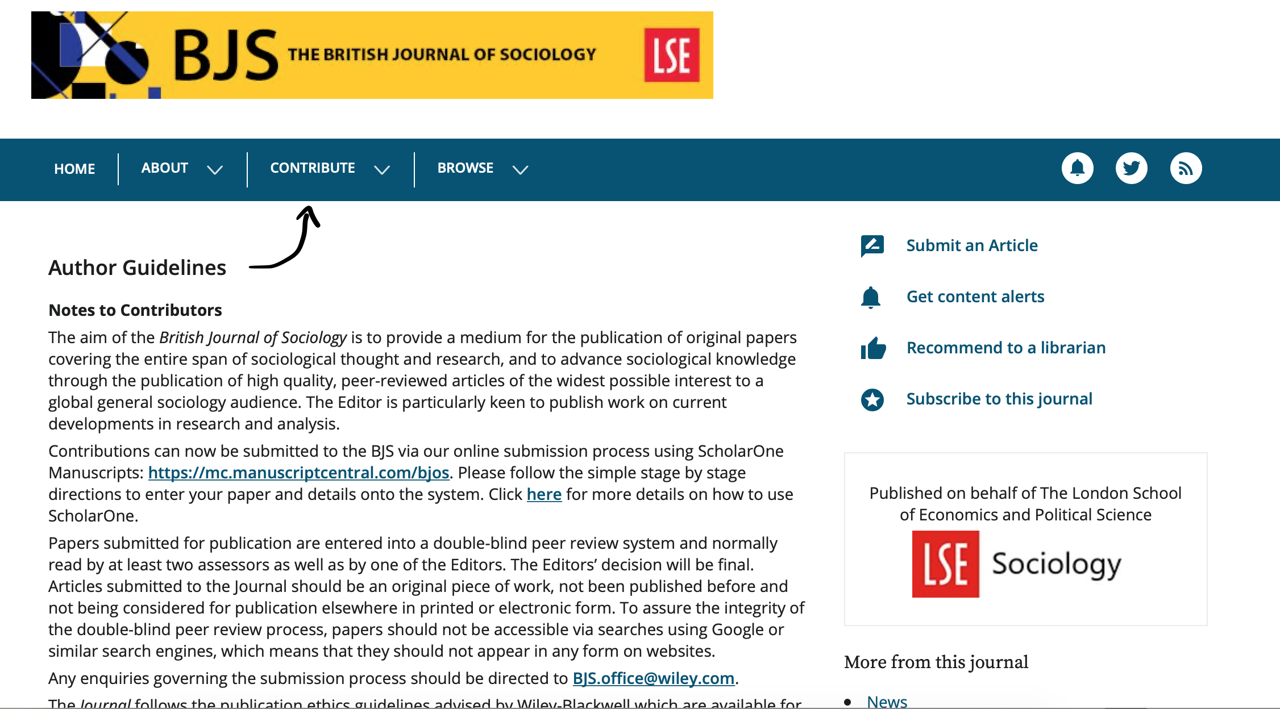
Always check author’s or submission guidelines!

Slide 7
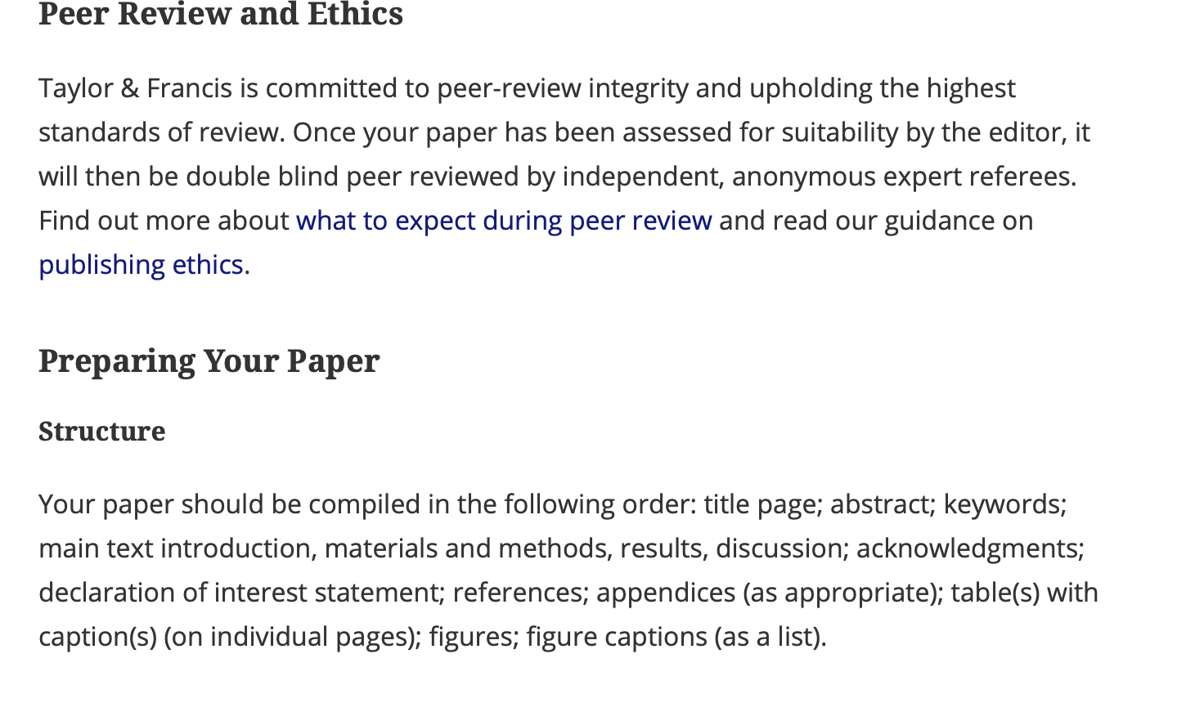

Slide 8
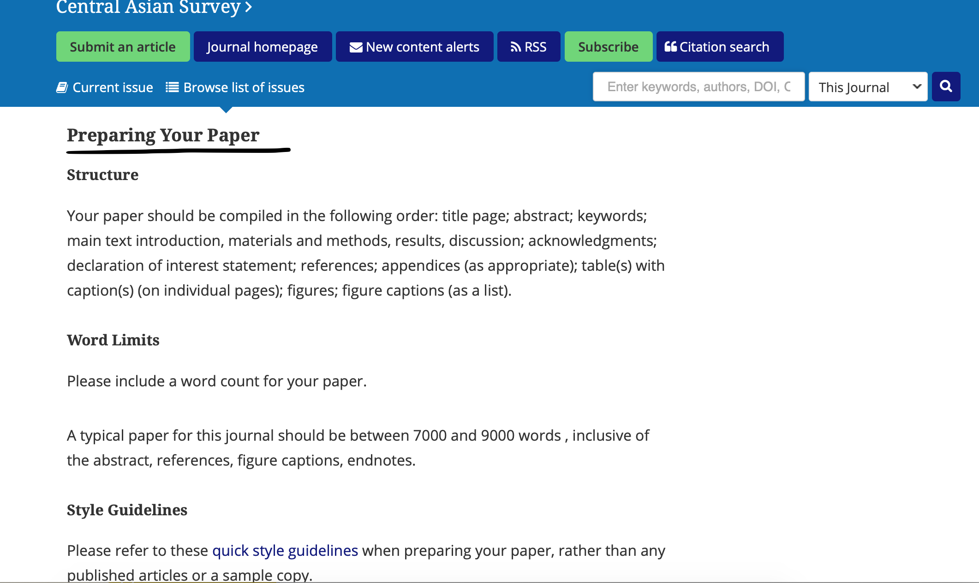

Slide 9
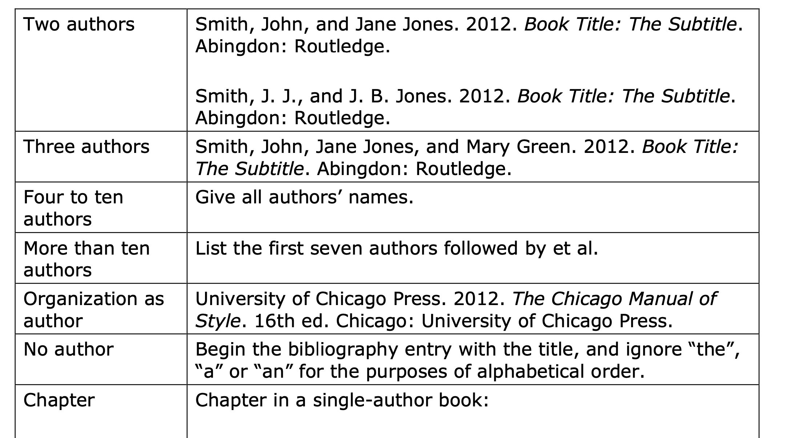

Slide 10
How to cite? Organise your citations and sources!
Each journal has its own citation style – it is ALWAYS mentioned in great detail in author’s or submission guidelines for each journal, publishing house, etc. – read that section extra carefully!
Organise your sources appropriately:
Folders
Mapping
In footnotes while writing
In diaries

Slide 11
Contribution and Literature Review
Make a habit of searching keywords through Google Scholar - you can choose the most recent publications or the most relevant (check how many citations they have and by whom these are cited)
Who are the main scholars in your field? What do they say and why this matters?
How your ideas are different or similar to these theories and ideas?
Where does your argument fit?
For the journal article you always need to make the case for the editor that you know where you are making your contribution.

Slide 12
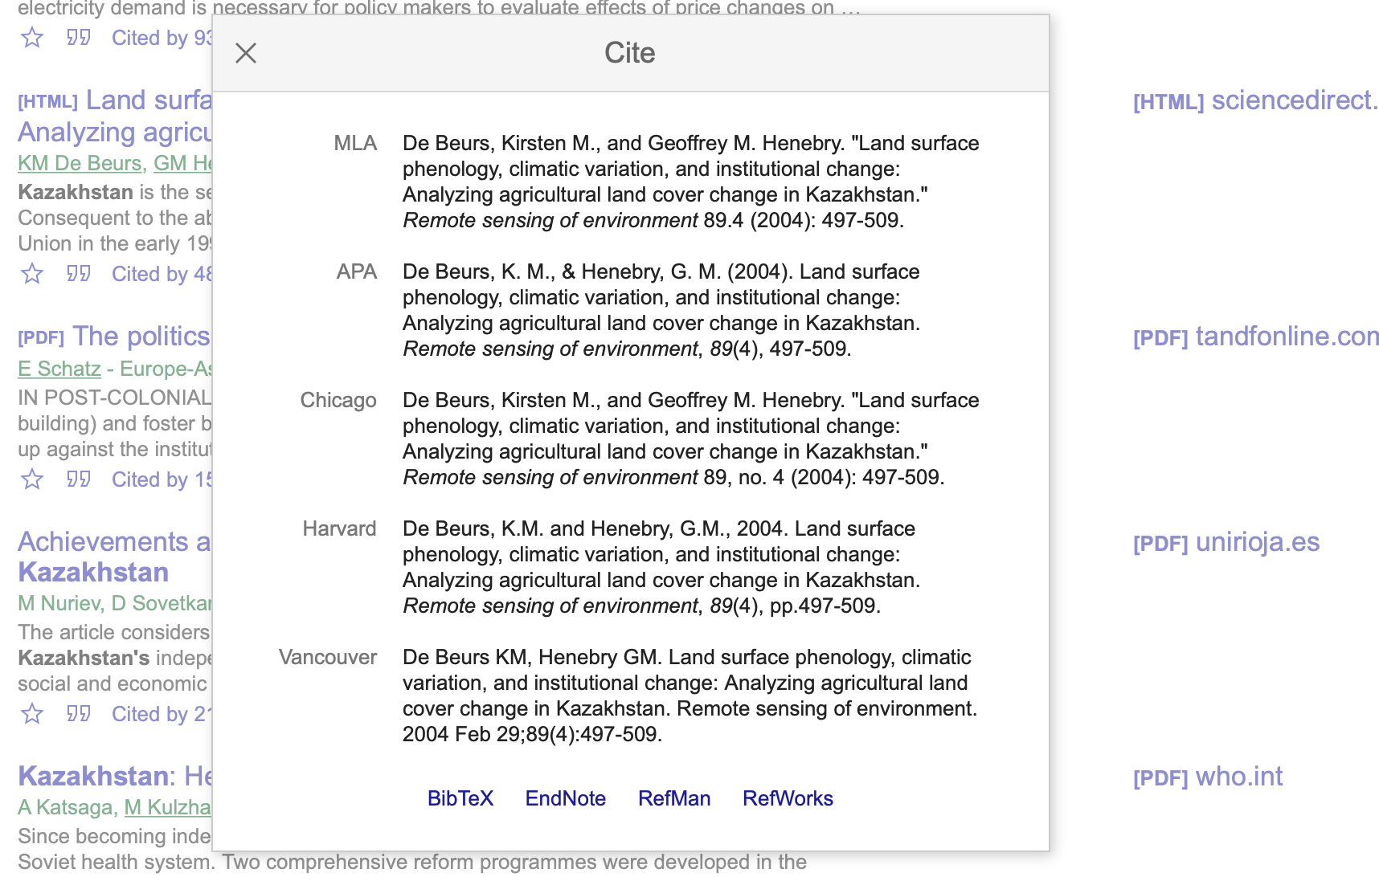

Slide 13
Quick elaboration before sending your paper to the journal of your choice
Choosing the journal:
Is this the journal where most of the authors I cite are publishing in?
Is this the journal that covers my interests?
Is my paper a good fit for this journal?
Writing the journal article:
Why is this article a valuable contribution to the field?
What new am I saying?
Why does it matter?
Where do I make my contribution?
How did I collect and analysed my data? What does it prove?
How do I prove my argument?

Slide 14
Other useful resources
Web of Science – search journals of your choice and in your area (follow Q1)
Join networking groups and events on academic writing in your community, for example, Central Asian Academic and Analytical Writing Support Community on Facebook.
Tune in for the writing master class events: tomorrow with Dr. Botakoz Kassymbekova, register here: https://roehampton-ac-uk.zoom.us/meeting/register/tZwsc-ytrDopGdKK_ynunjZlm_NJJXG0WR08?fbclid=IwAR3dXY9Yis8THGBPDs1YwJU1kC9aTM2zCahLAtJSu0wMadAyBoxy3AM0z2E
Submit your paper to the

Slide 15
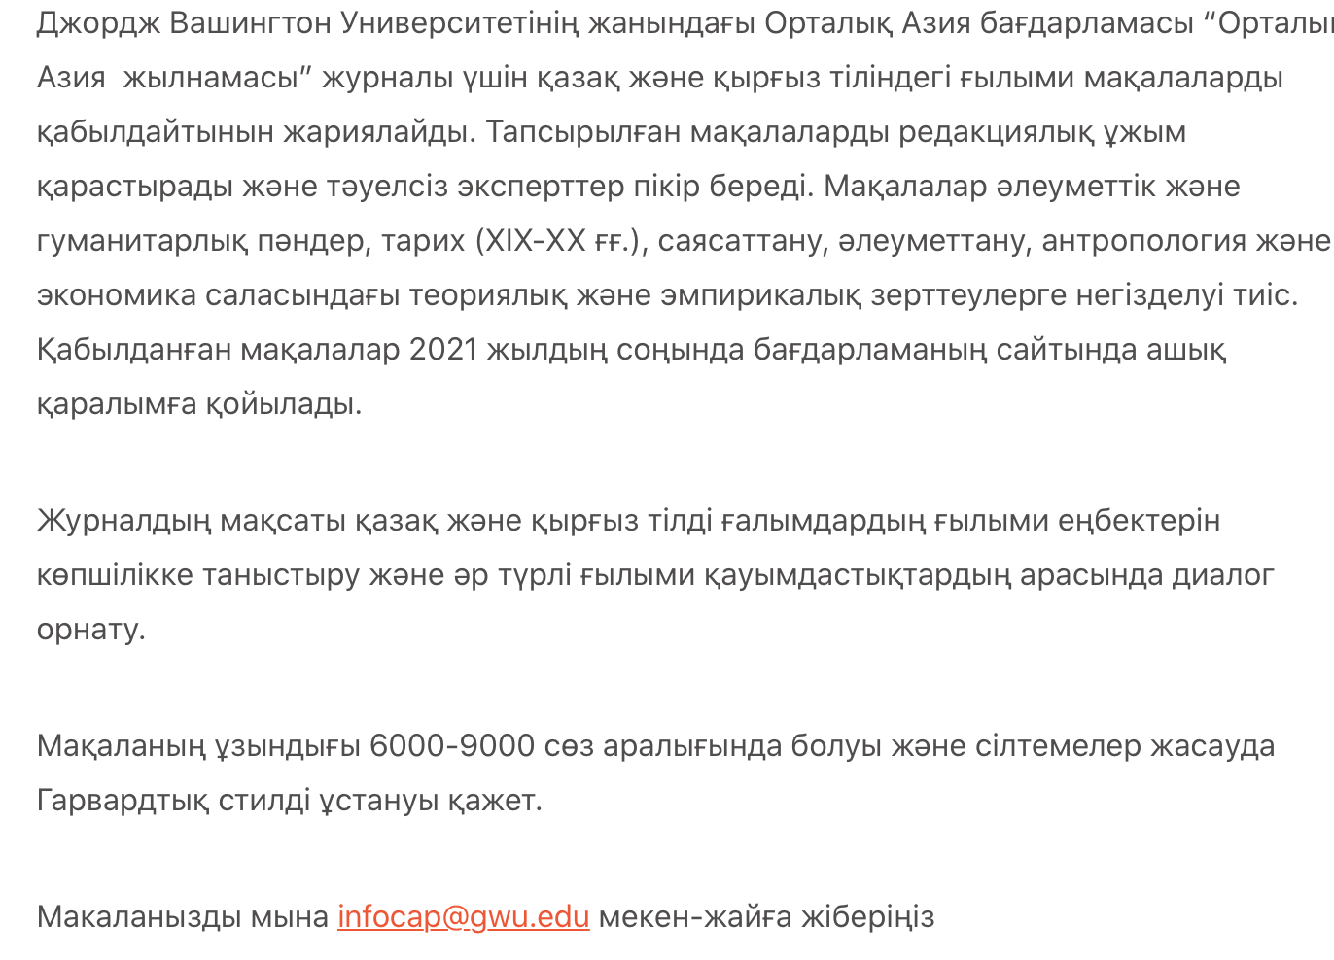
https://centralasiaprogram.org/archives/18468?fbclid=IwAR2yjre74FiRg1xQ2pCKx-MEXJ3cnyv2fPijEsfjY17vST5fvaZ_x0BH7a0

